Slide 1

Microsoft 365 platform community call
aka.ms/m365pnp
Your host in this call: Vesa Juvonen
May 17, 2022

Slide 2




Agenda
Latest updates and news on the Microsoft 365 platform
Group picture time with Together Mode!
Demos
Mounika Narayanan - Integrate Graph connector content on Office.com
Waldek Mastykarz and Paolo Pialorsi (PiaSys) - Your Microsoft 365 app within the fingertips of employees with Viva Connections

Slide 3
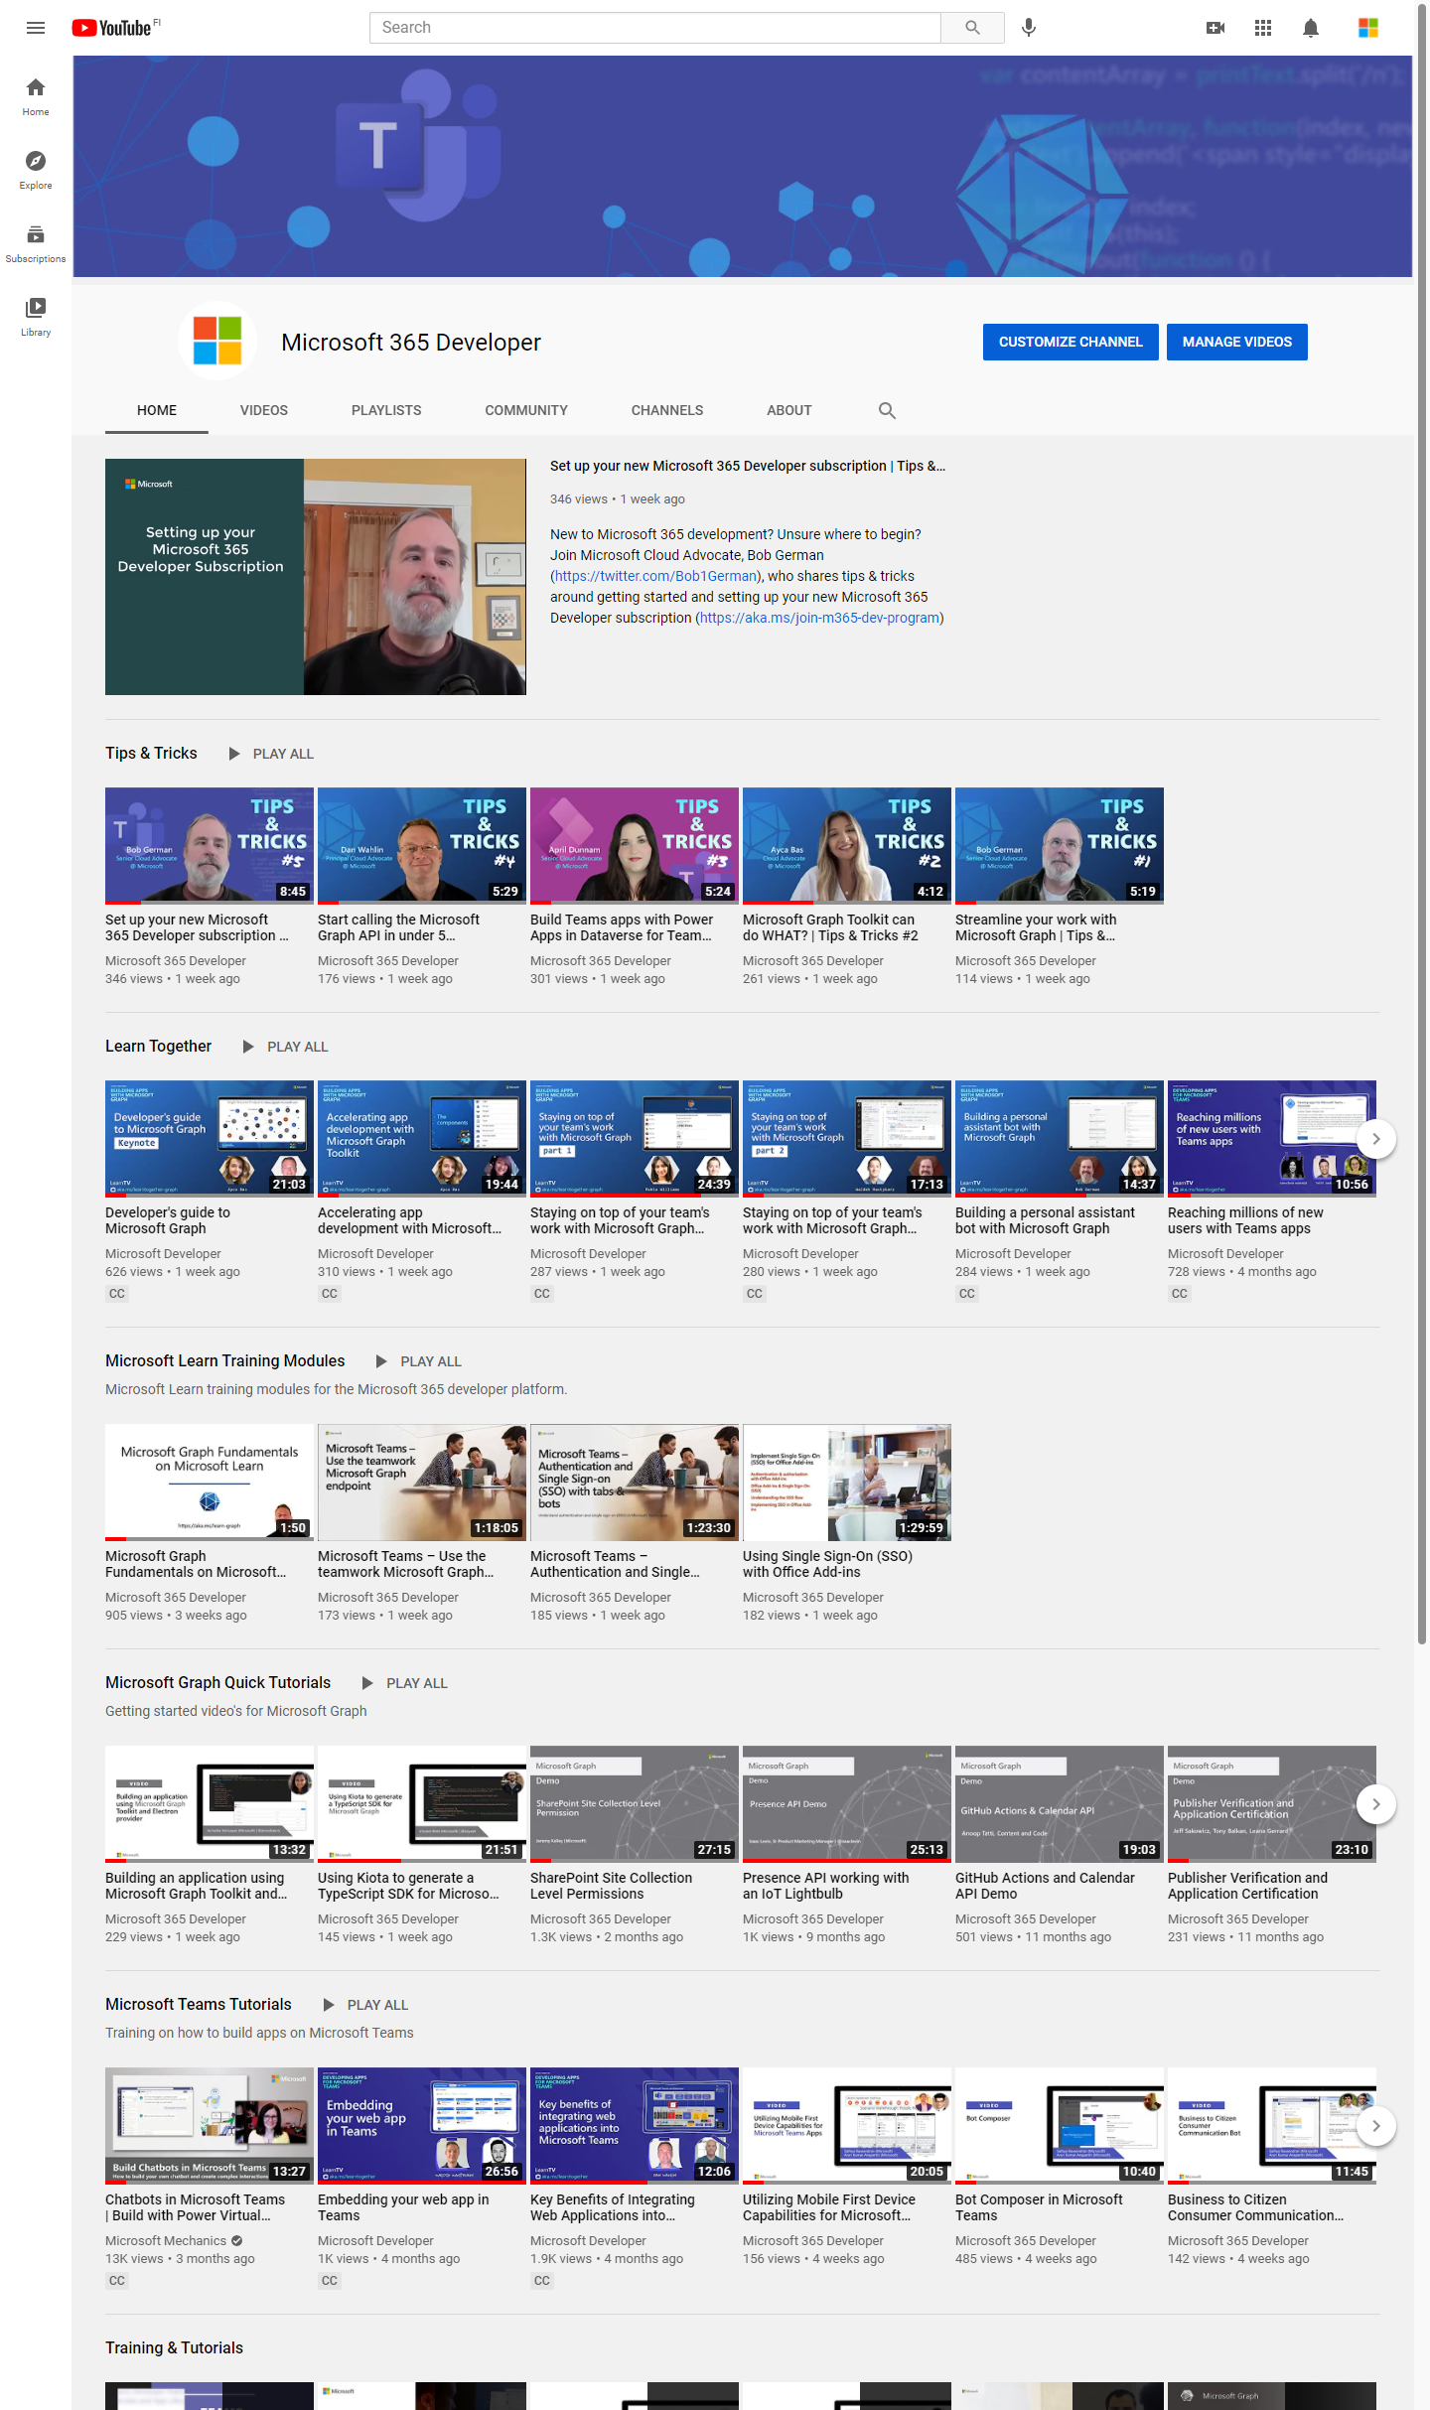
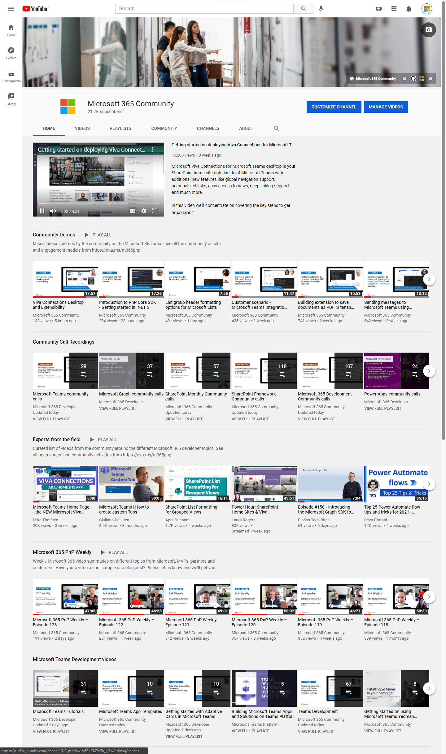
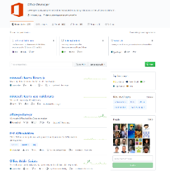
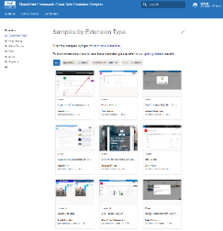
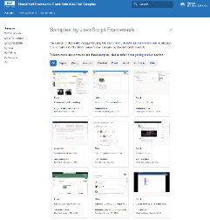
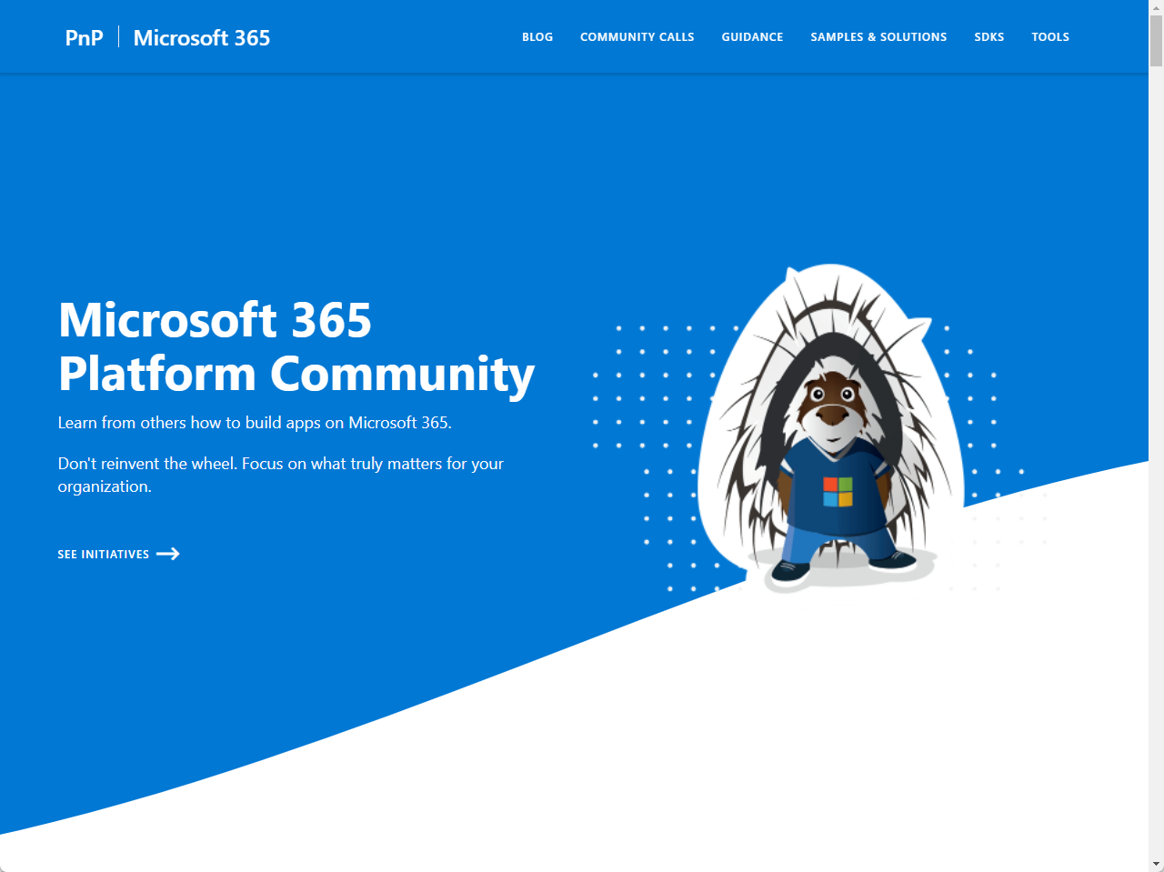
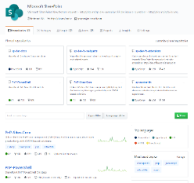
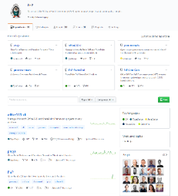
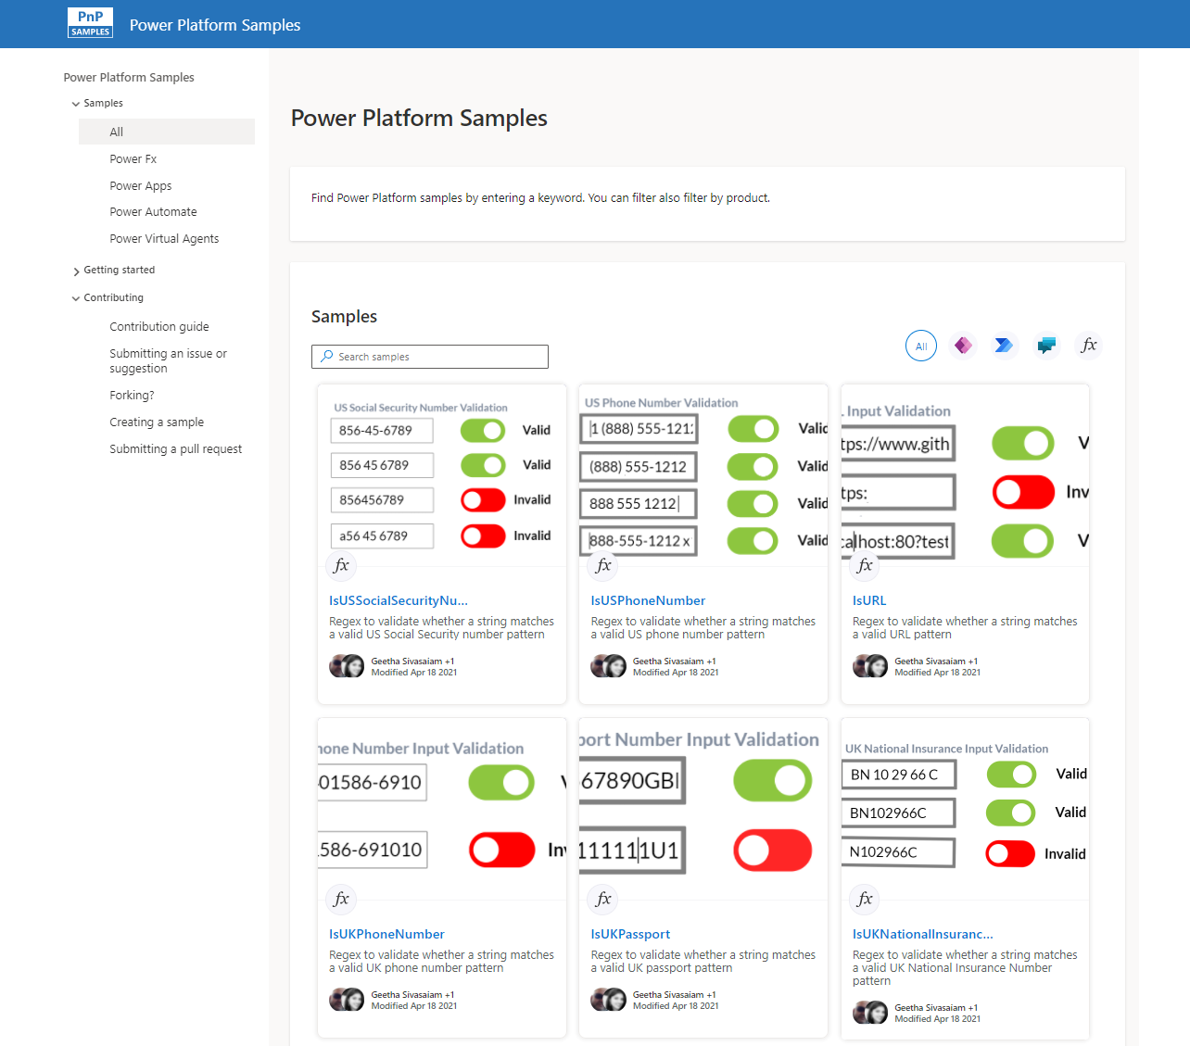
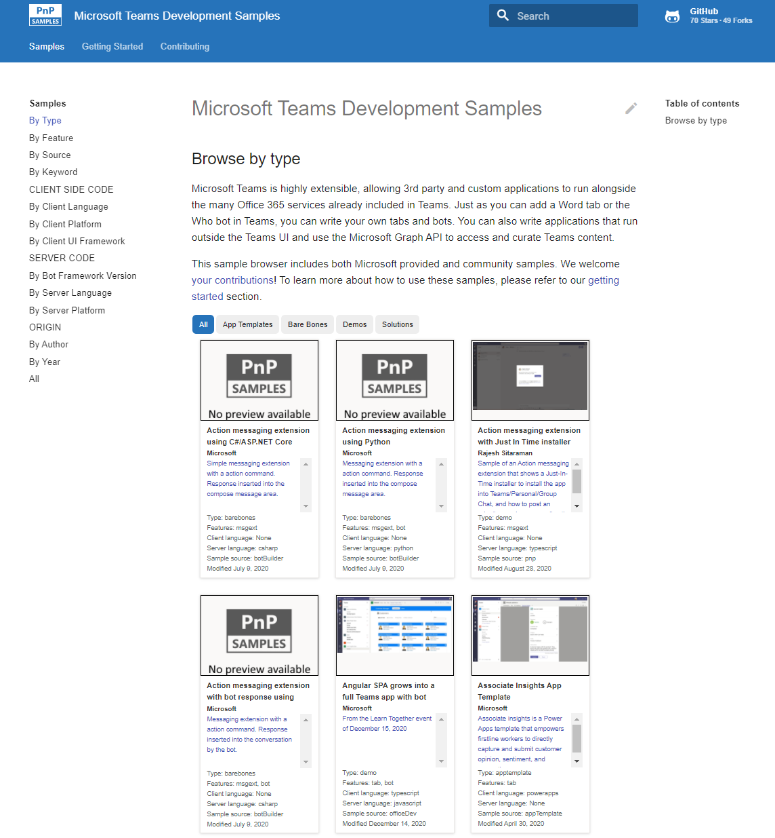
Microsoft 365 developer videos
Microsoft 365 community videos
Open-source
Sample galleries
Open-source initiatives and samples
aka.ms/m365devyoutube
aka.ms/m365/videos
github.com/pnp
github.com/officedev
github.com/sharepoint
github.com/microsoftgraph
aka.ms/m365/samples
aka.ms/teams-samples
aka.ms/spfx-webparts
aka.ms/powerplatform-samples
aka.ms/spfx-extensions
aka.ms/list-formatting
aka.ms/m365/community
@Microsoft365Dev | @m365pnp

Slide 4
Microsoft 365 developer community calls
Microsoft 365 platform (weekly) https://aka.ms/m365-dev-call
(Notice. This call is on a summer break between July 1st and 31st of August 2022)
Adaptive Cards https://aka.ms/adaptivecardscommunitycall
Microsoft identity platform https://aka.ms/IDDevCommunityCalendar
Office Add-ins https://aka.ms/officeaddinscommunitycall
Power Platform https://aka.ms/PowerAppsMonthlyCall
Microsoft 365 and Power Platform community (bi-weekly) https://aka.ms/m365-dev-sig
Viva Connections & SharePoint Framework (bi-weekly) https://aka.ms/spfx-call
Download recurrent invites from
https://aka.ms/m365/calls
Notes:
m365-dev-sig

Slide 5
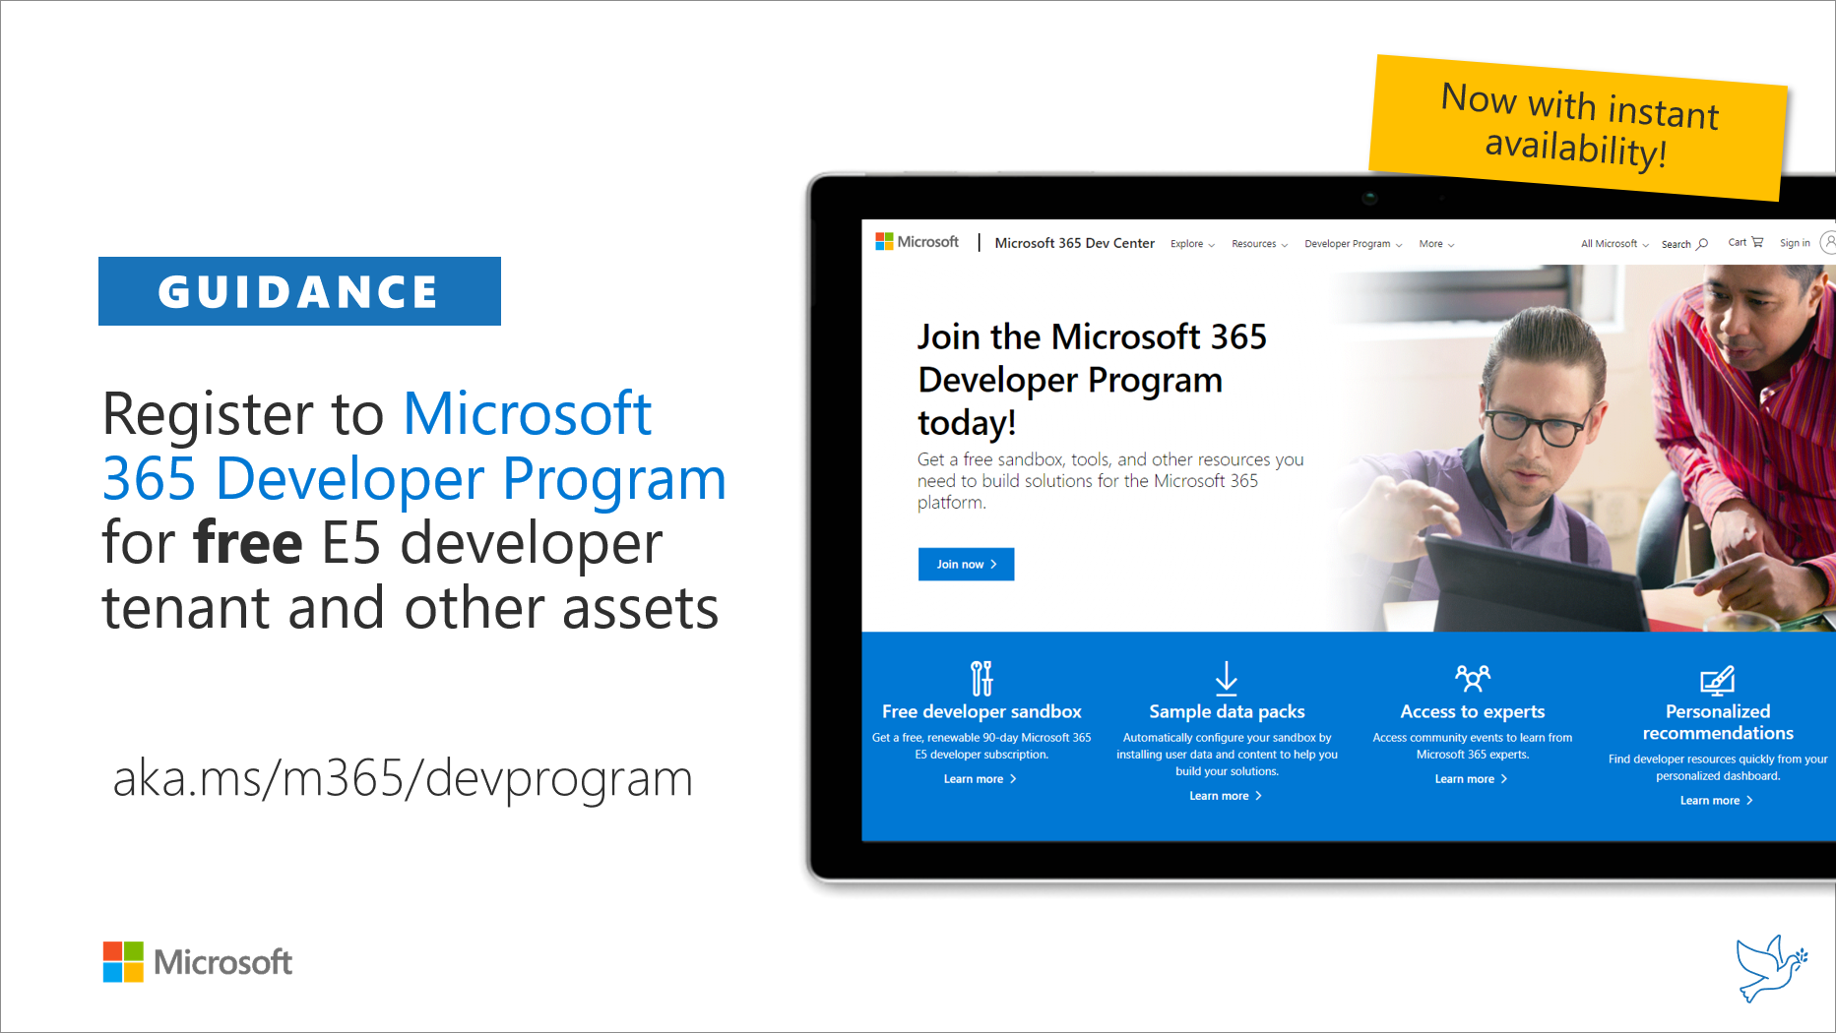
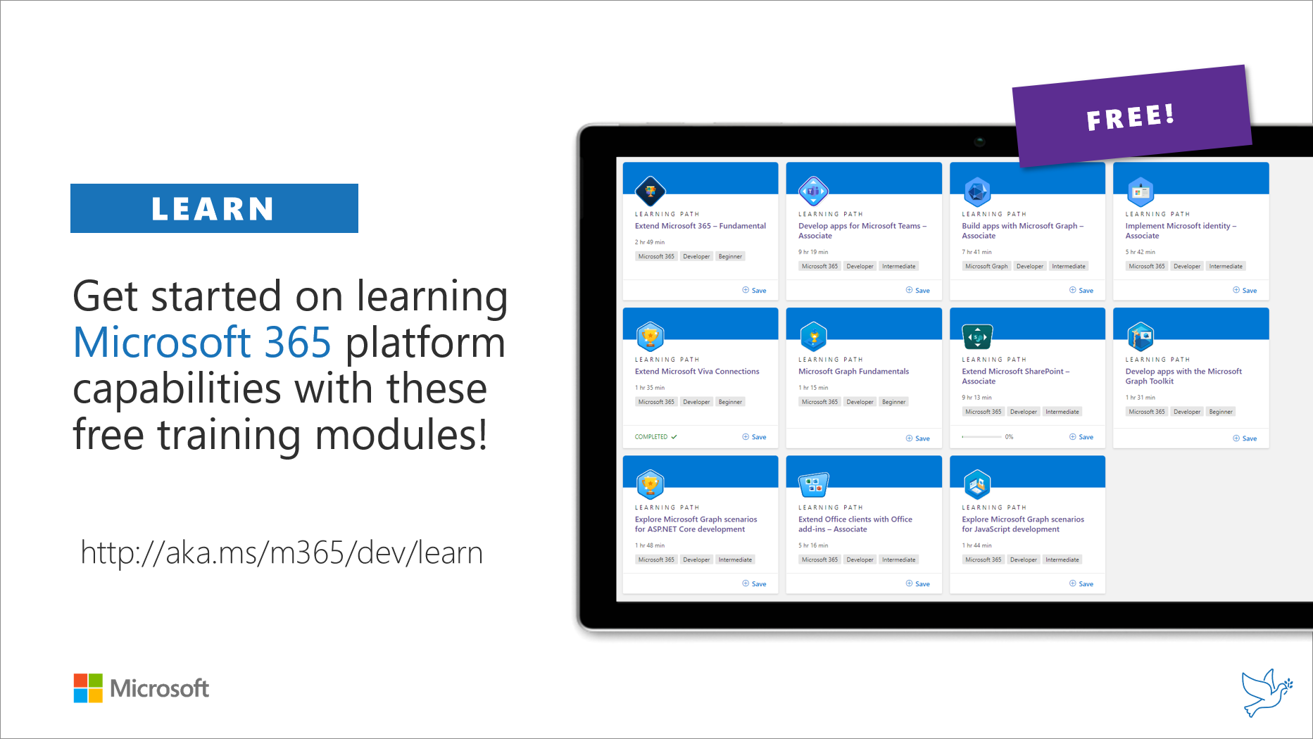
Getting started assets for Microsoft 365 dev
aka.ms/m365/devprogram
aka.ms/m365/dev/learn

Slide 6
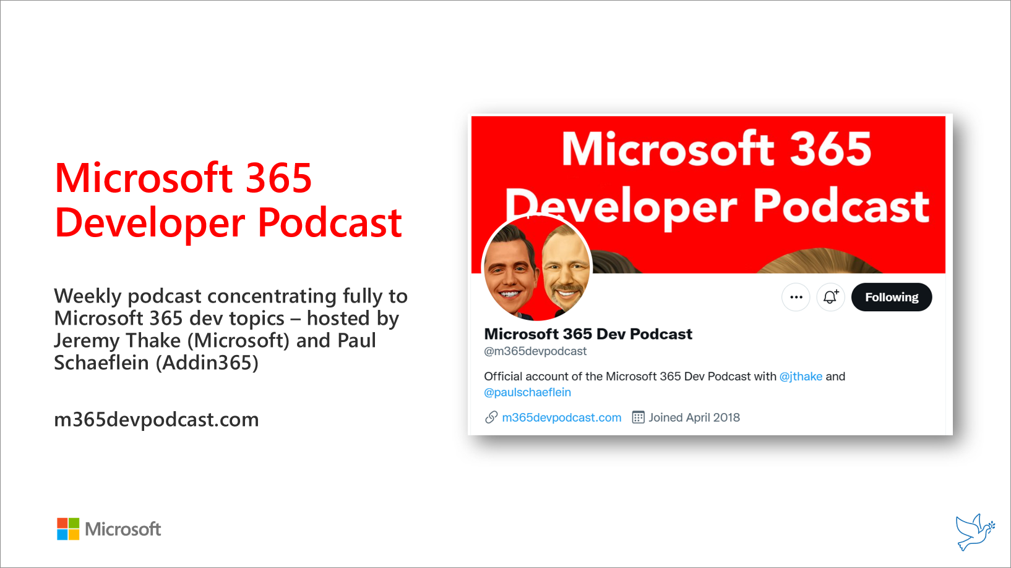
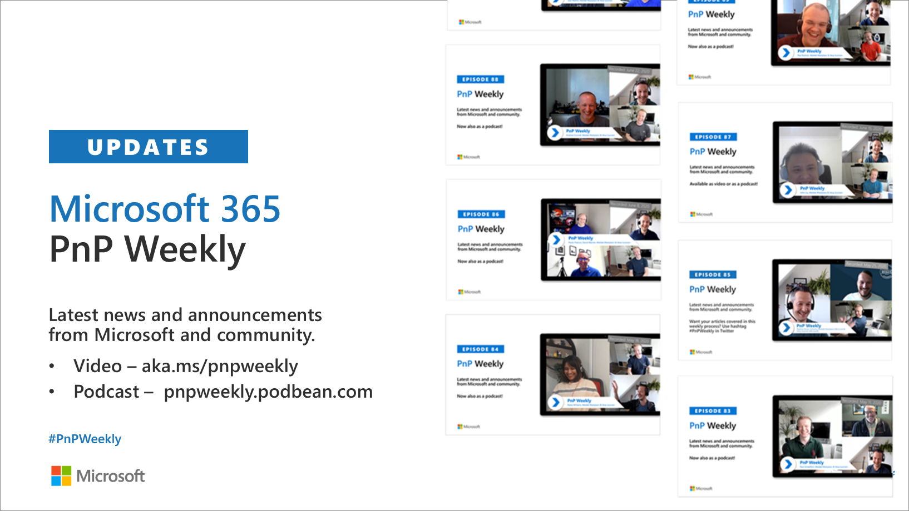
Microsoft 365 Developer podcasts
m365devpodcast.com
Video – aka.ms/pnpweekly
Podcast – pnpweekly.podbean.com

Slide 7
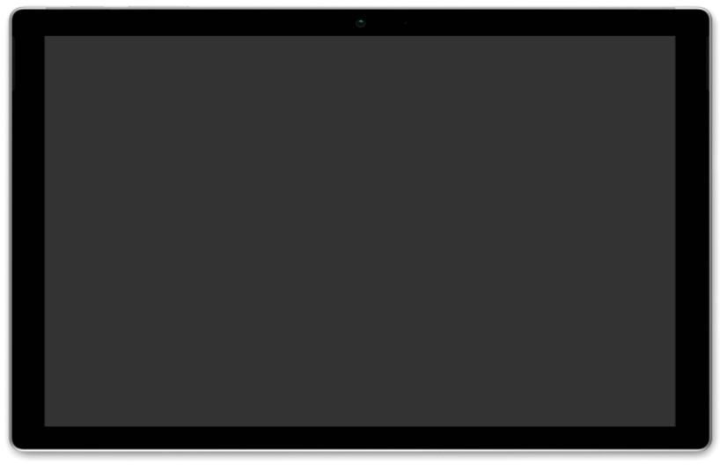
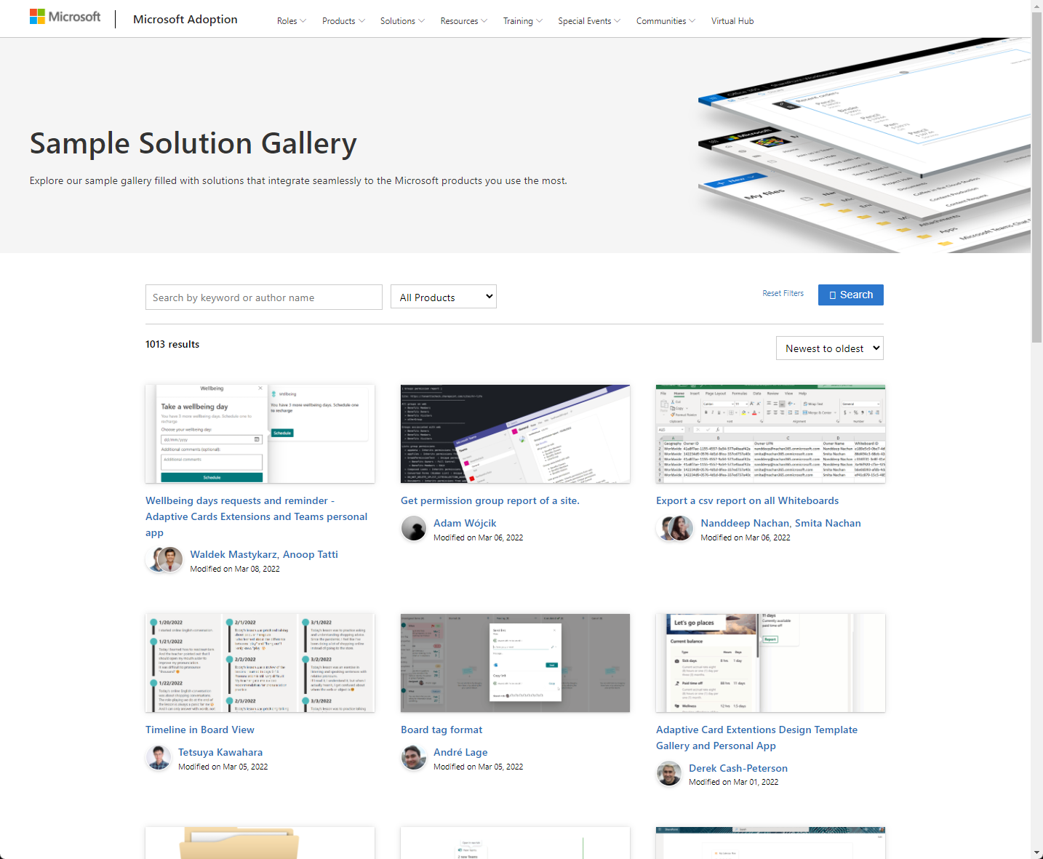
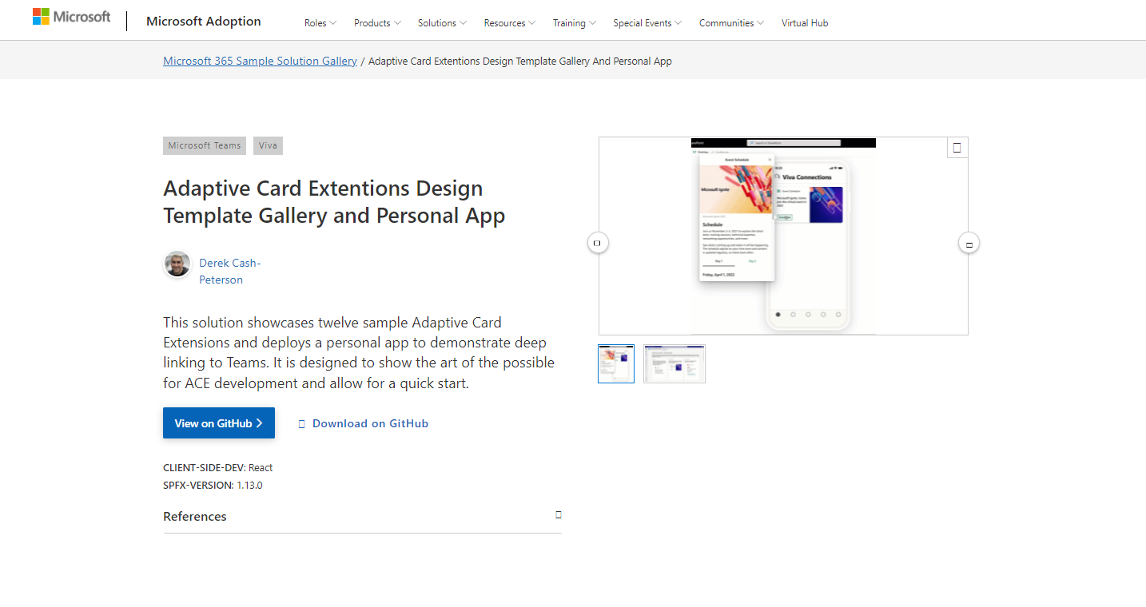
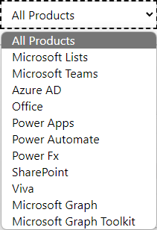

SAMPLES
New Microsoft 365 sample gallery with more than 500 samples from Microsoft and community
1065
aka.ms/m365/samples

Slide 8
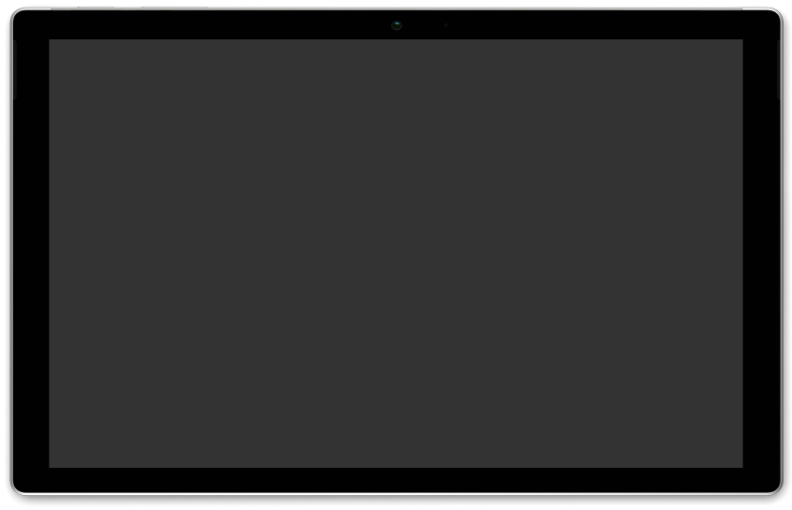
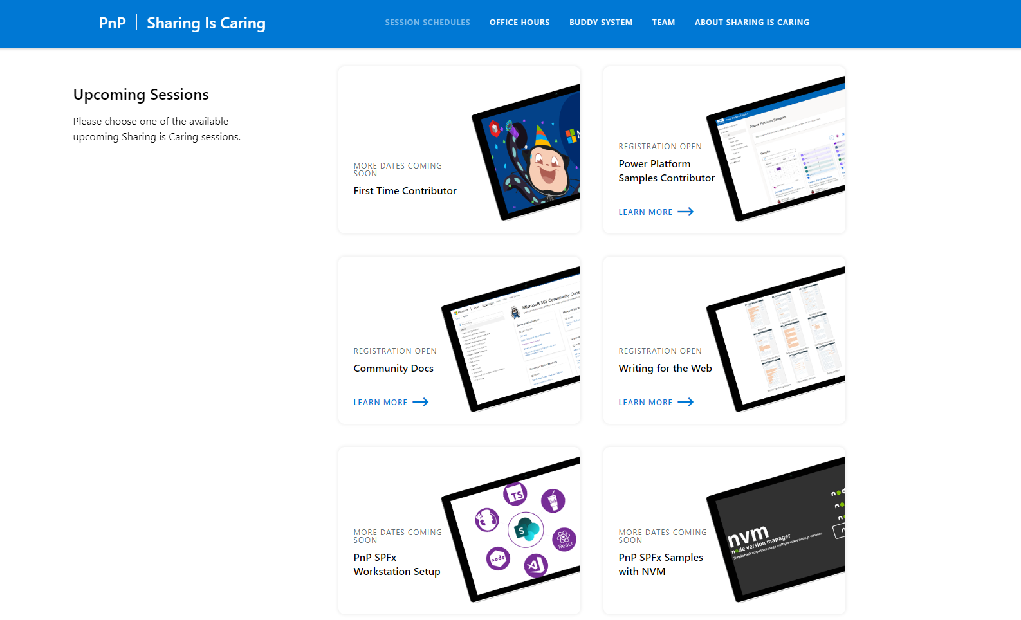
GUIDANCE
Learn how to get started in the open-source PnP community!
Upcoming Sessions:
General First Time Contributor
Power Platform Samples – First Time Contributor
Community Content Docs
Writing for the Web
SPFx Developer Workstation Setup
Using PnP SPFx samples w/ NVM
More than code with VS Code
First-time presenter
M365 Maturity Model Practitioners
https://aka.ms/sharing-is-caring
Notes:
25 Total attendees, 16 attendees who attended both First-Time Contributors and Community Docs sessions.

Slide 9

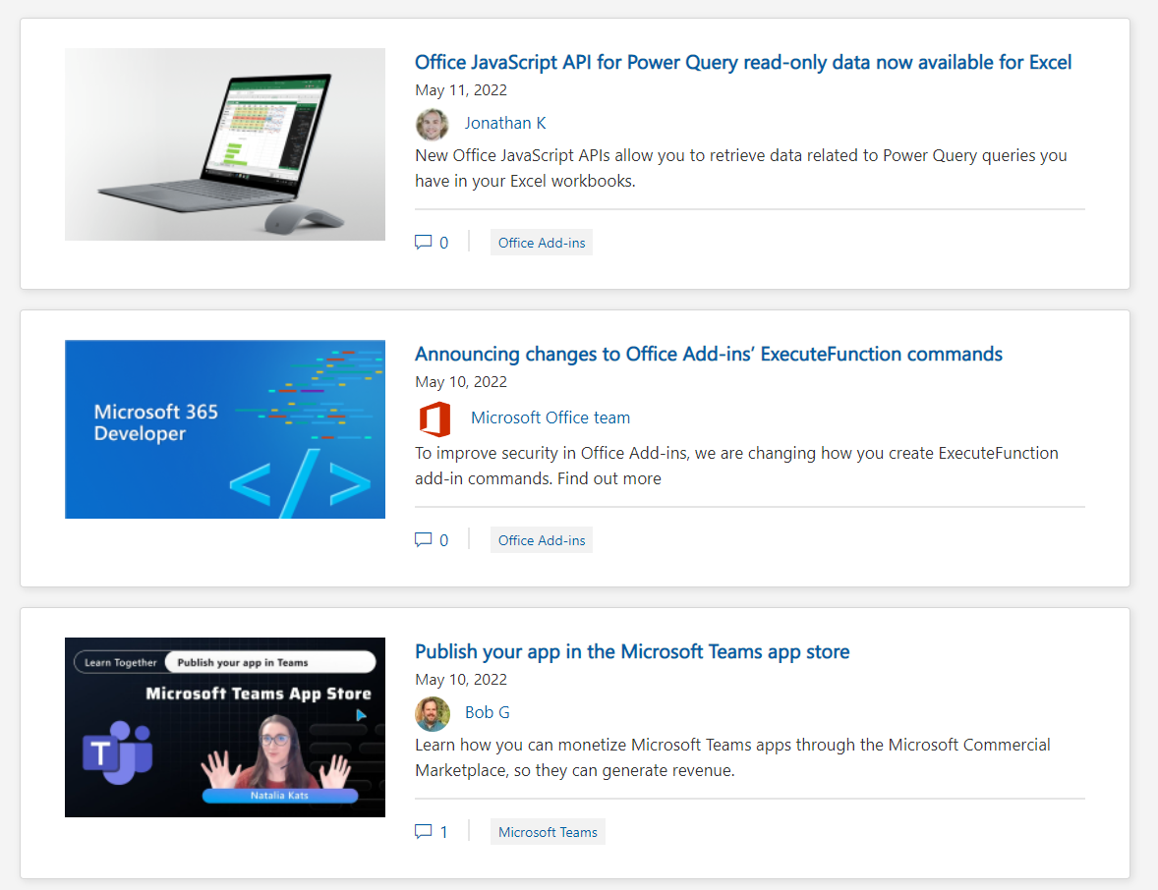
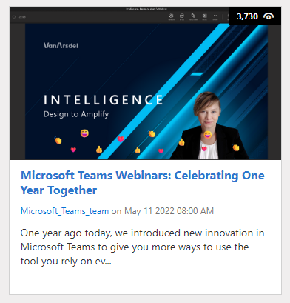
https://aka.ms/m365dev/blog
https://aka.ms/teams/blog
https://aka.ms/microsoftviva/blog
Notes:
New pull as needed sync model for content types along with APIs
Recap news and announcements from Enterprise Connect including Teams Rooms, RSVP options for hybrid meetings, and more
Follow up to initial customer story with Atlassian to dive deeper into Teams app
Tips and tricks for using Power Automate to track and collaborate on tasks

Slide 10
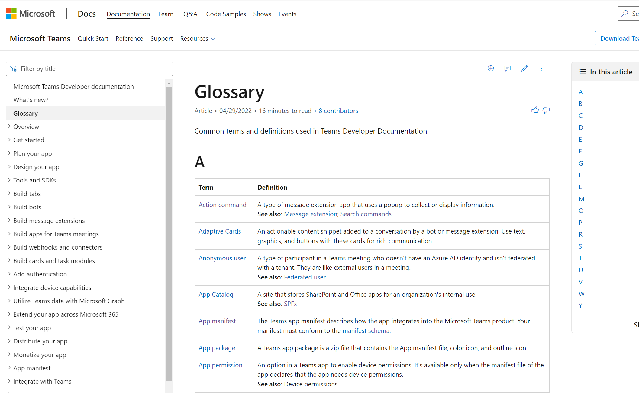
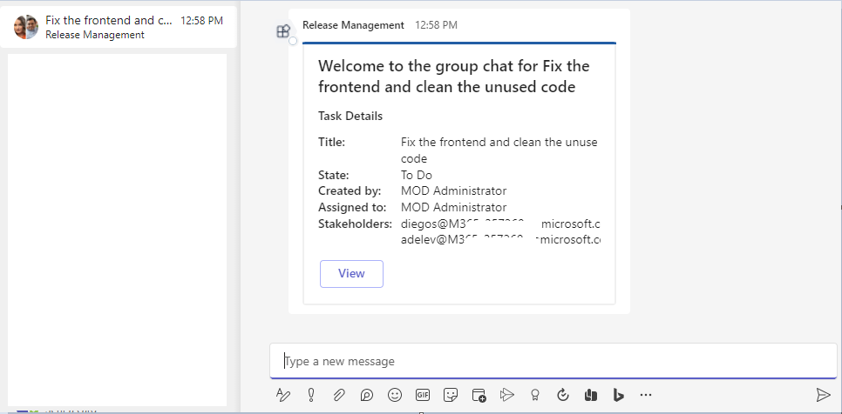






Teams Platform updates Sample code
Doc updates Glossary
1
Release management – Bot + Graph + Azure DevOps webhooks
2
Repo: aka.ms/TeamsSamples > samples > bot-release-manager
Docs: http://aka.ms/TeamsDevDocs > Glossary
@Microsoft365Dev
aka.ms/TeamsPlatformUpdates
aka.ms/TeamsDevDocs
aka.ms/TeamsSamples
aka.ms/TeamsPlatformFeedback
Notes:
Surbhi covering 5/17/2022 Hello everyone. I’d walk you through the platform and documentation updates. Let’s start with the platform update on the left side.
We’ve published new scenario-based sample which shows how respective stakeholders can get notified when new work item is created in Azure DevOps. This sample listens to work item created even and creates a group chat with stakeholders using Graph APIs. It also sends a proactive message in the group chat with Task details of newly created chat using Bot. This can also be extended to post regular updates. This sample is already published in GitHub repo at aka.ms/TeamsSamples/ bot release manager folder.
Now let’s move to the doc updates on the right
We’ve introduced “Glossary”, and we believe it’d help you find the definition (or information) about a term quickly, without the need for searching outside our docs. If you’d want us to add more terms or have any feedback, please do let us know.
So, these were the platform updates, if you have any feedback or suggestion, please post on aka.ms/TeamsPlatformFeedback- the link is available in the footer. You could also follow us on twitter and configure to the RSS feeds to get regular platform updates.

Slide 11

EVENT
Microsoft Build
May 24-26
Registration now open:
https://mybuild.microsoft.com

Slide 12
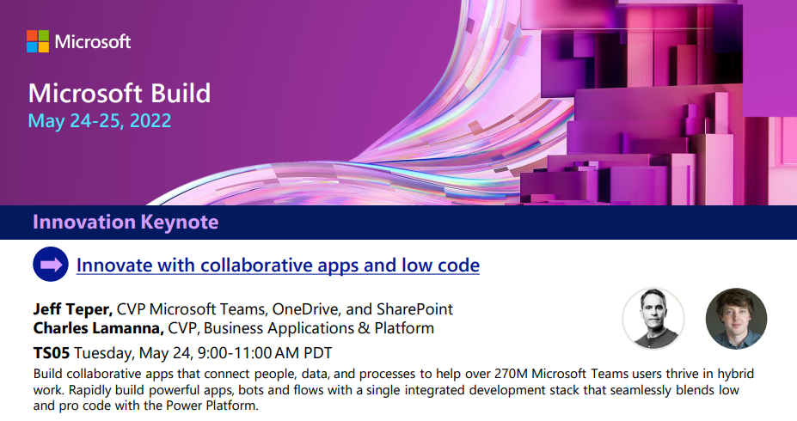
SCHEDULE
Collaborative Apps session introduction now available
Breakout sessions, on demand videos, Ask The Experts, Product Roundtables and more… 🚀
https://aka.ms/teamssessions

Slide 13


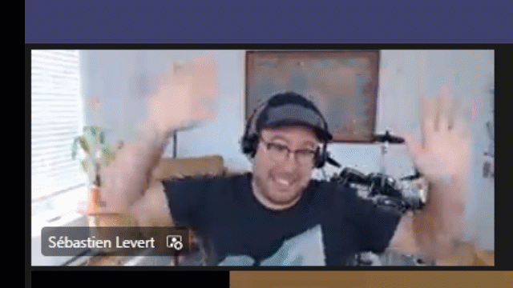
Optional picture time!
Video on and we’ll grab a Together Mode pic with those who are willing to do this.
We are together on this as a community!
Let’s all be like Seb
By enabling your camera for the picture, you grant us permission to share your picture in social media.

Slide 14

DEMO
Integrate Graph connector content on Office.com
- Mounika Narayanan
Your Microsoft 365 app within the fingertips of employees with Viva Connections
- Waldek Mastykarz
- Paolo Pialorsi (PiaSys)

Slide 15
Thank you
Recording will be available in 24 hours on
Microsoft 365 Community (PnP) YouTube channel
https://aka.ms/M365PnP/videos
(subscribe today)
Follow us on Twitter
@Microsoft365Dev | @M365PnP
Next Microsoft 365 Platform call: May 24th at 08:00 am PT
All available community calls from https://aka.ms/m365/calls

Slide 16



aka.ms/m365pnp

